Slide 1
NW CUSTOM AIRCRAFT HANGARS Duane Wilcoxon 425-418-3680
We are a licensed and bonded company based in Arlington Washington. We can provide the following services.
Custom Aircraft Hangars
Custom Hangar Doors
On site manufacturing of steel roofing and siding.
Lic # NWCUSWC826C6

Slide 2
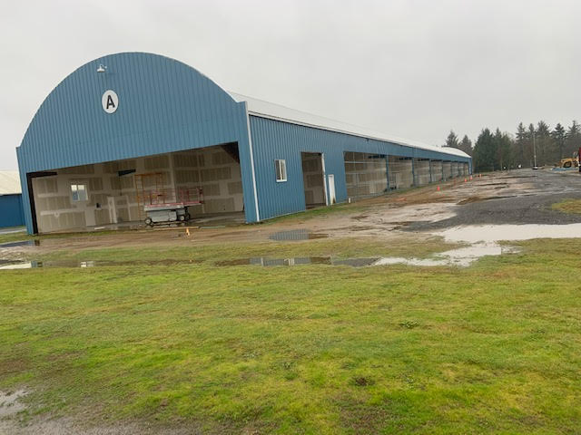
Custom hangar build at Arlington Municipal Airport
Three part project. Land leased from Arlington Municipal Airport. 18 units complete. 36 additional units will be built and available for purchase. T Hangar design.
For additional information contact Duane Wilcoxon 425-418-3680
Website www.nwaircrafthangars.com

Slide 3
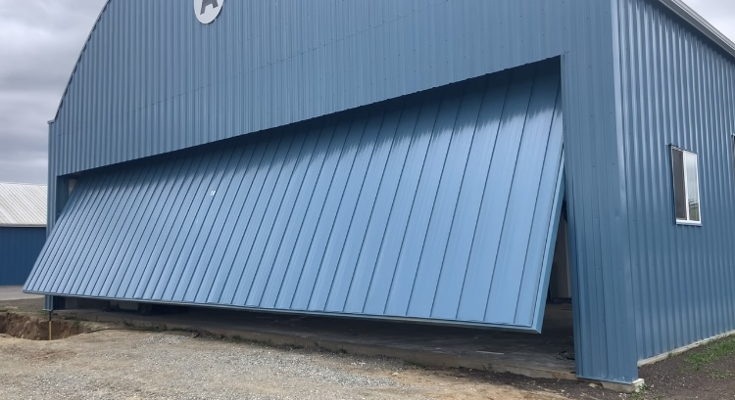
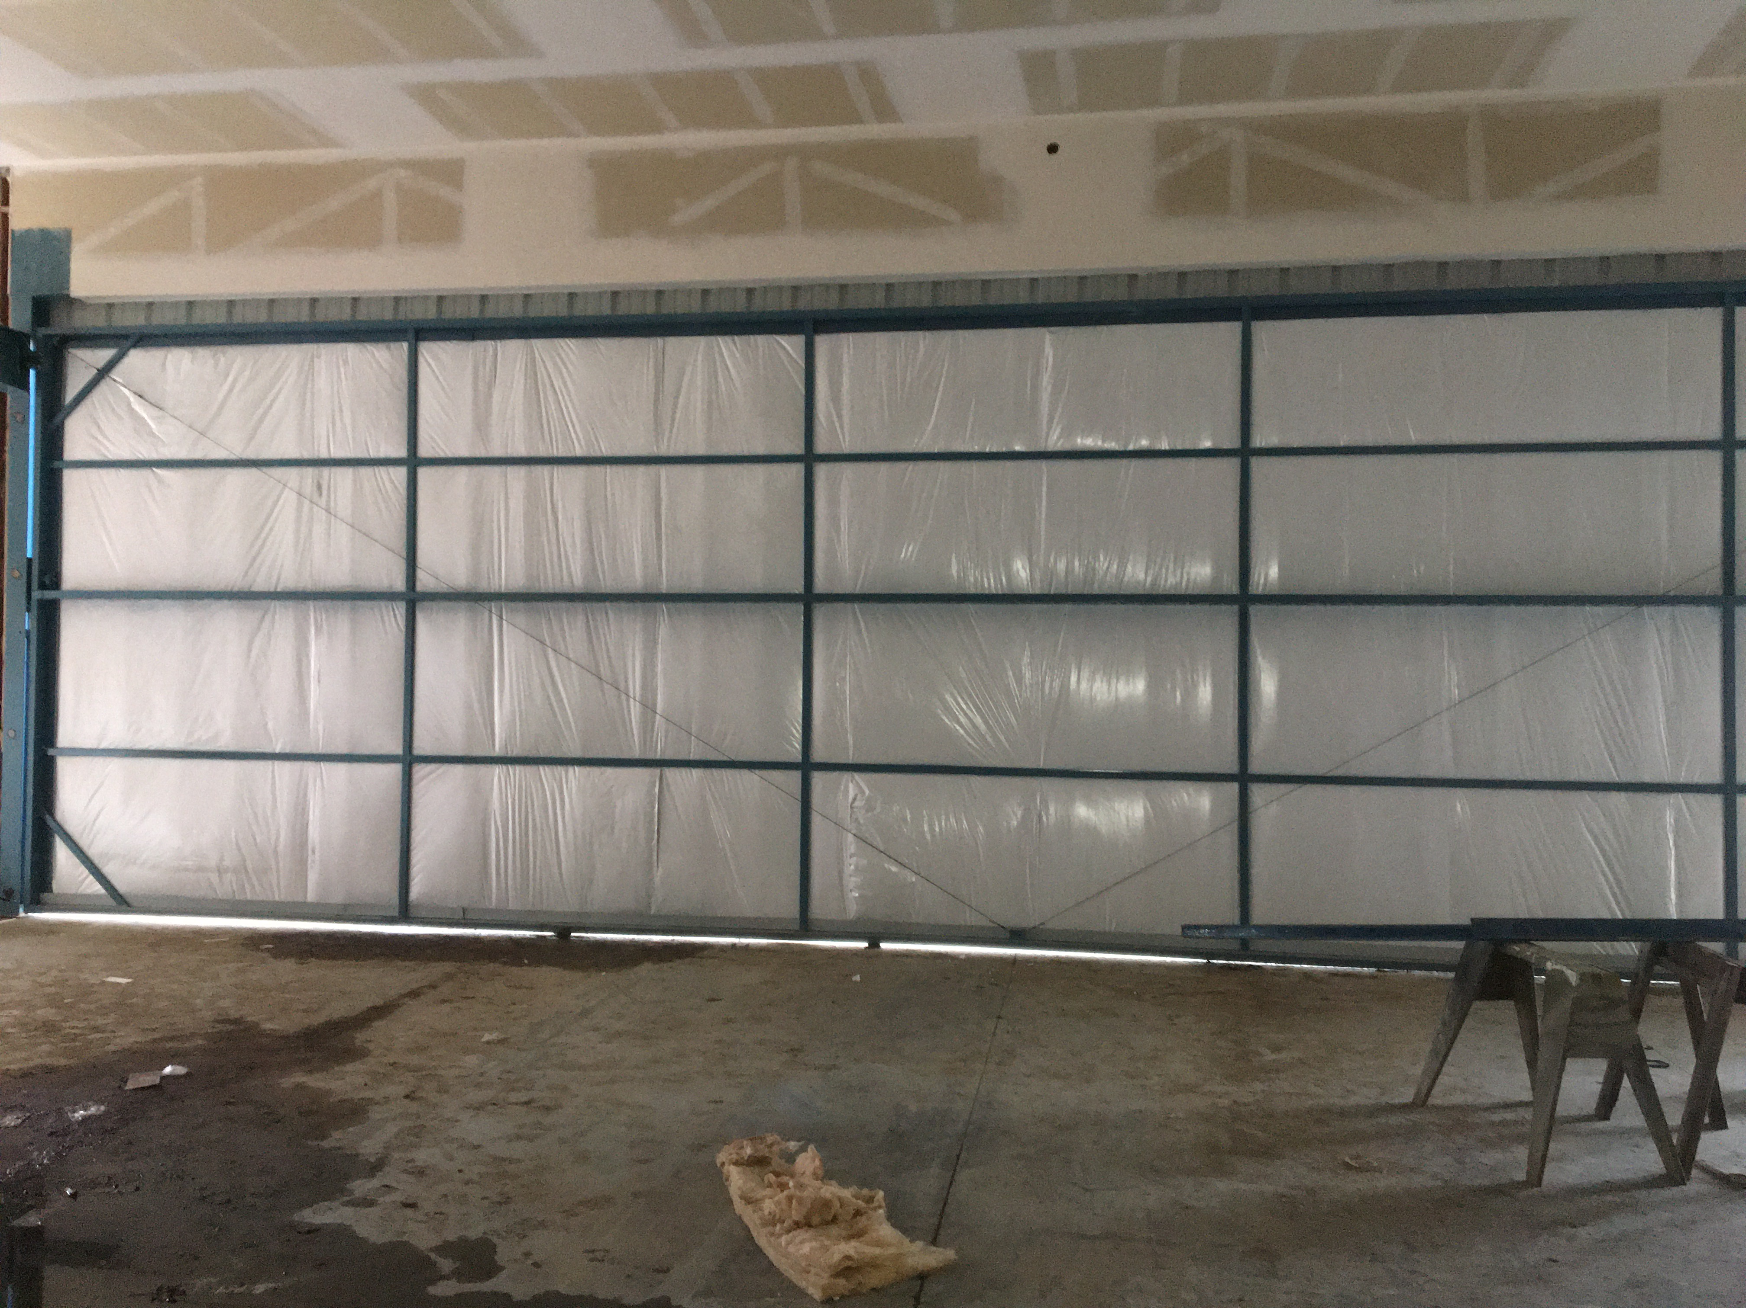
Custom aircraft hanger doors.
. Built to your specifications
Notes:
Doors shown here are 14’X45’ and 17’X54’

Slide 4
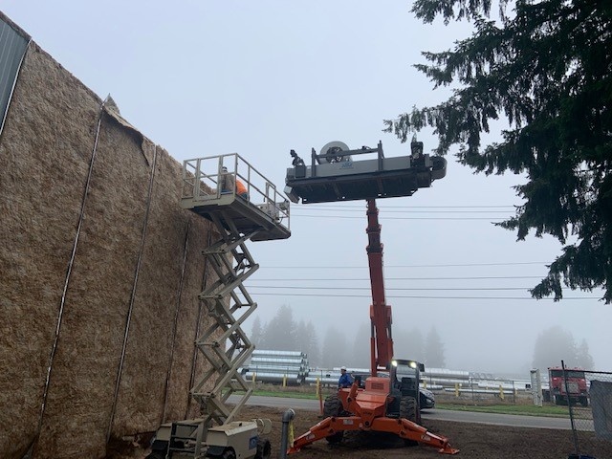
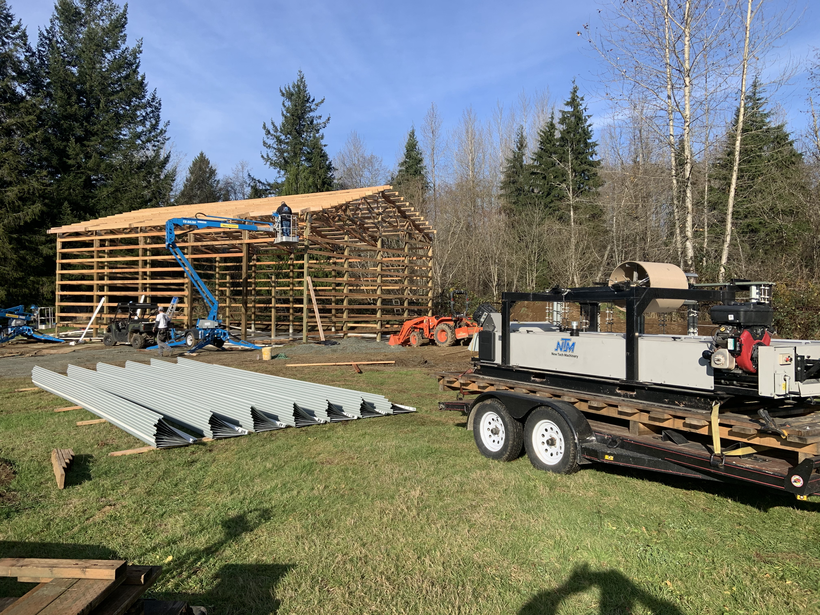
Provide onsite steel roofing and siding.
Many profiles available.

Slide 5
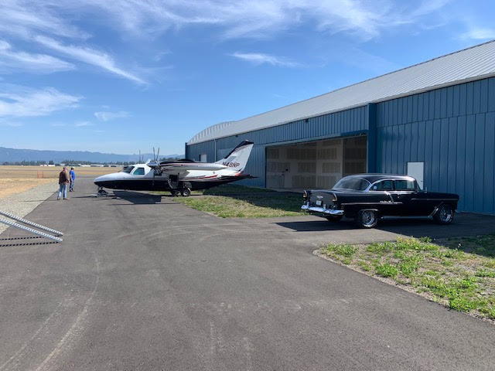
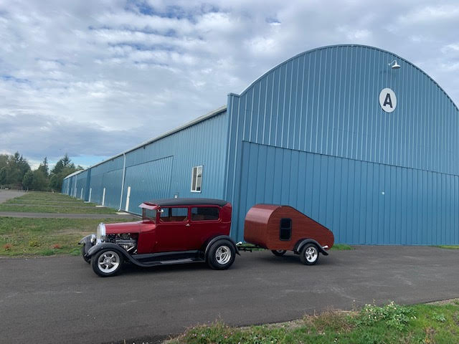
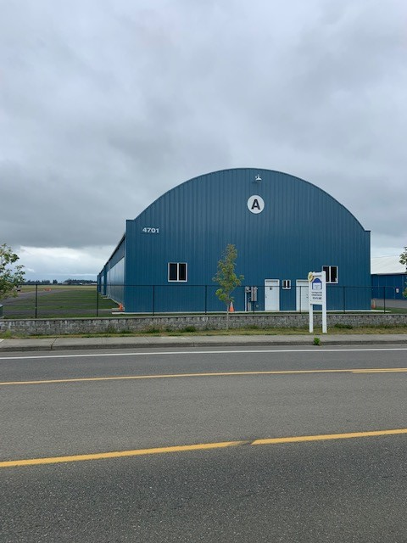
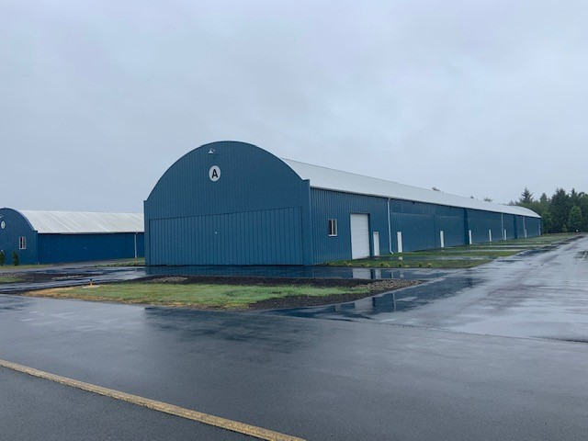
Photo Gallery

Slide 6
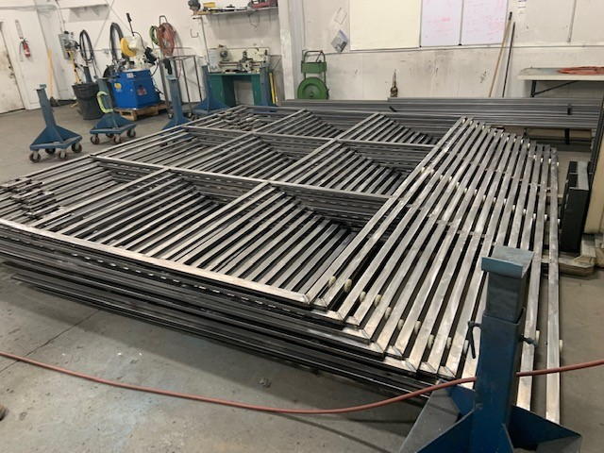
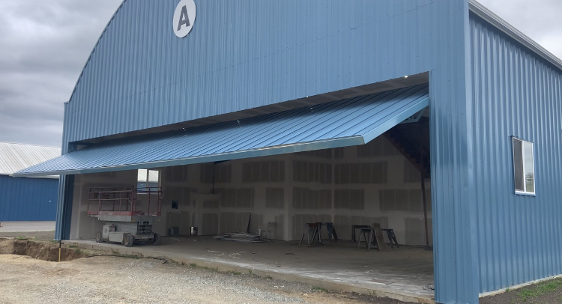
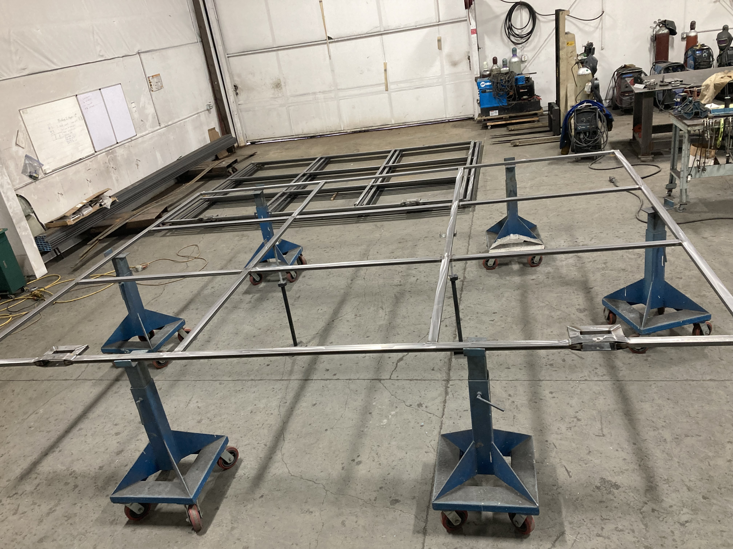
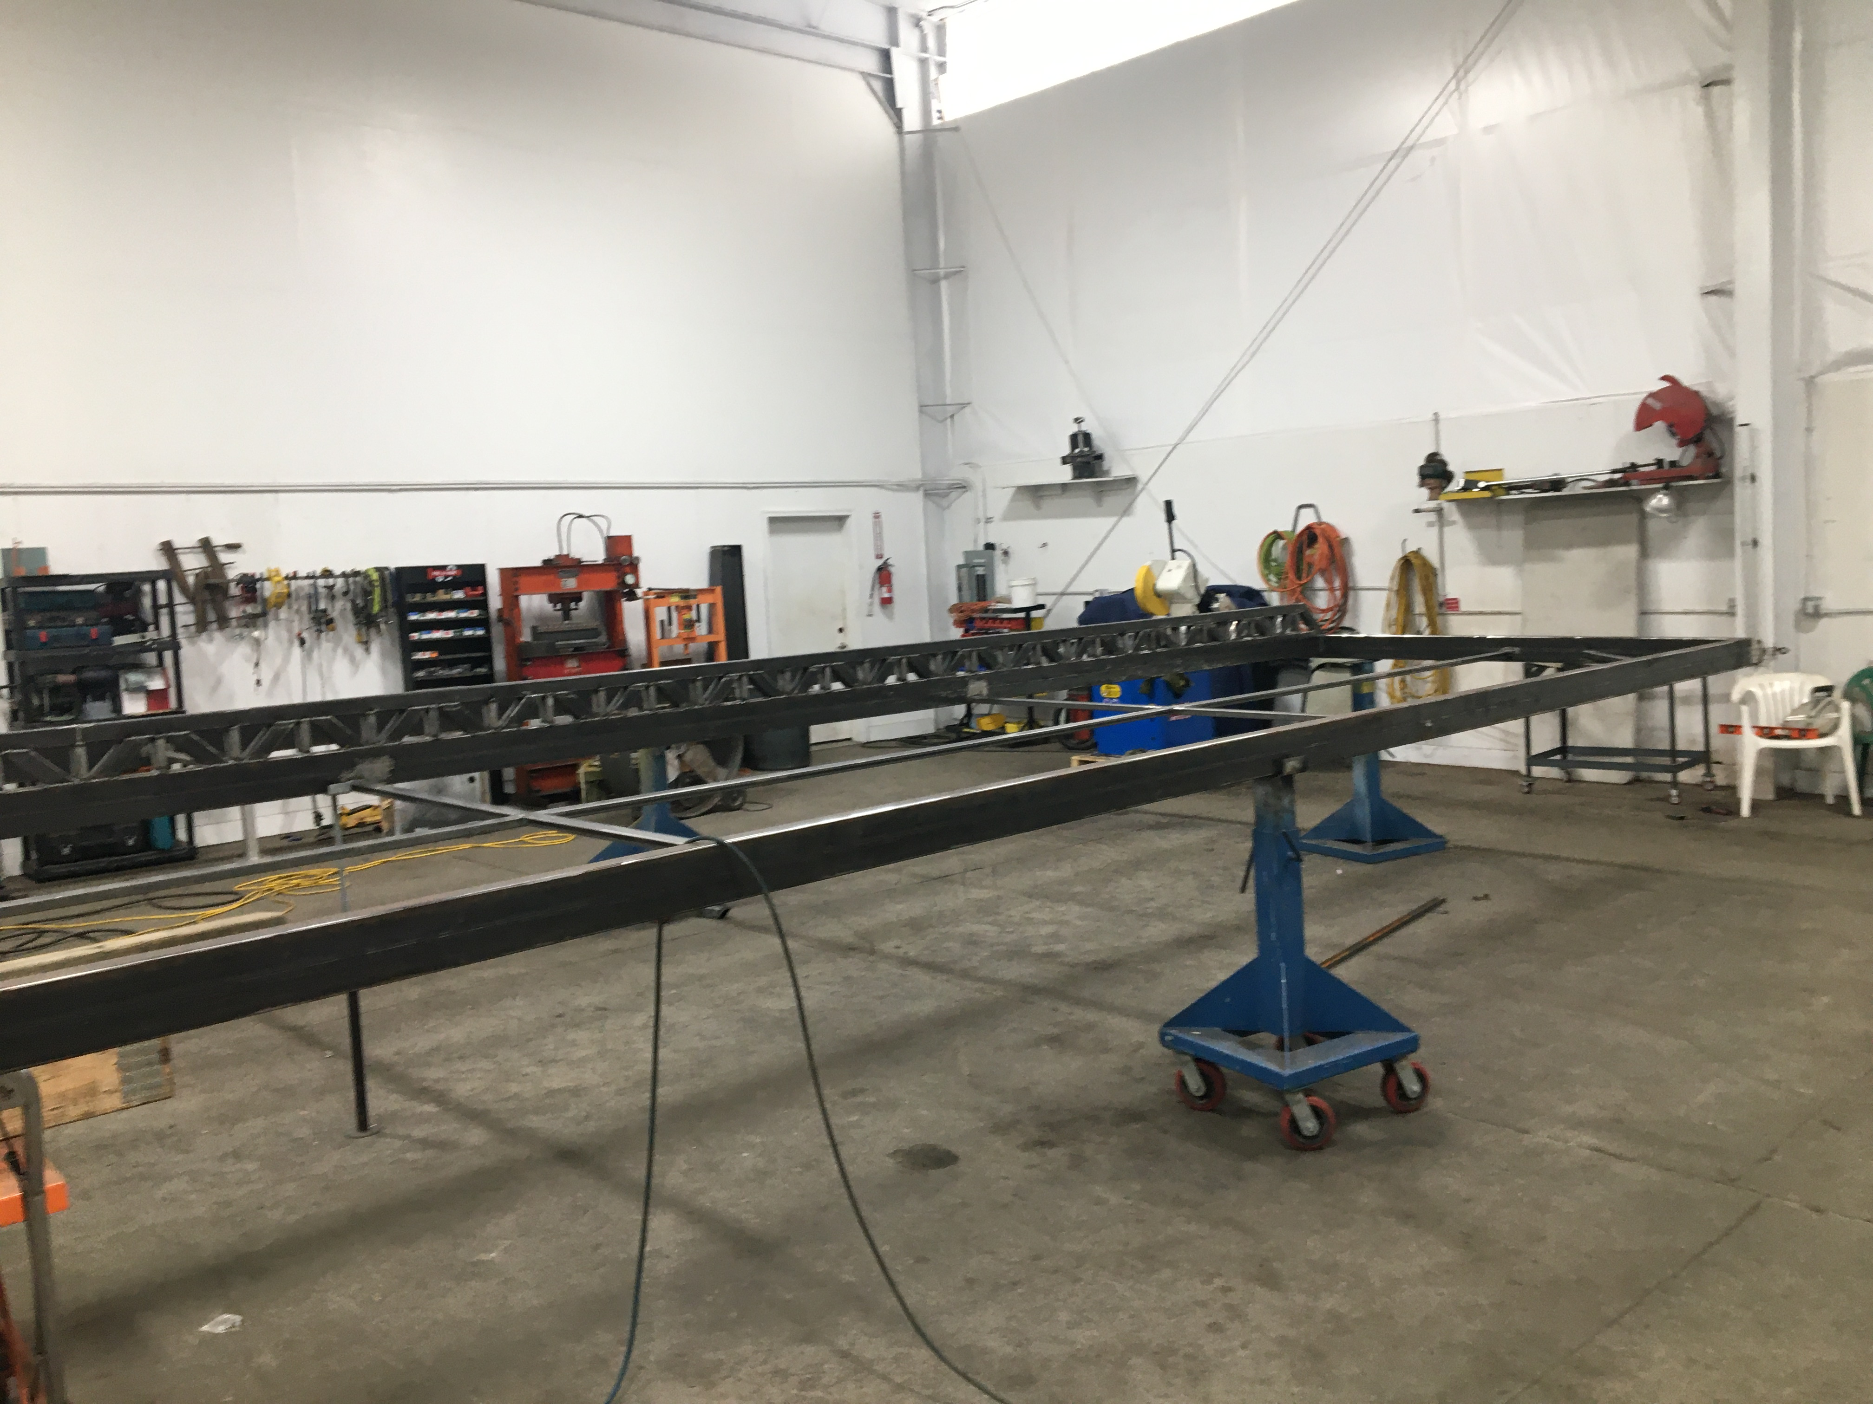
Notes:
Custom doors under construction.

